Slide 1
UNIT I - S7,S8,S9- Topics
OPTICAL FIBER MODES, OPTICAL FIBER CONFIGURATIONS, SINGLE MODE FIBERS, MULTIMODE FIBERS, STEP INDEX FIBERS, GRADED INDEX FIBERS

Slide 2
Optical fiber modes
Optical fiber is classified into 2 categories
1. Number of modes
Single Mode Fiber (SMF)
Multi Mode Fiber (MMF)
Refractive Index
Step Index (Single mode/ Multimode)
Graded Index

Slide 3
Based on Number of Modes

Slide 4
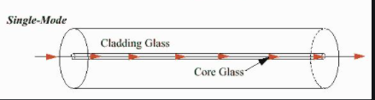
Single mode fiber
Only one mode can propagate through the fiber
Core diameter (5um) and high cladding diameter (70um)
Difference between the R.I of core and cladding is very small.
There is neither dispersion nor degradation therefore it is suitable for long distance communication.
Light is passed through the single mode fiber through laser diode.

Slide 5
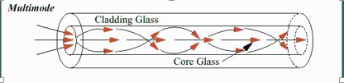
Multimode fiber
Allows large number of modes for light ray travelling through it.
Core diameter is 40un and Cladding is 70um
The relative refractive index is larger than single mode fiber.
Due to multimode dispersion, signal degradation takes place.
Not suitable for long distance communication due to large dispersion and attenuation.

Slide 6
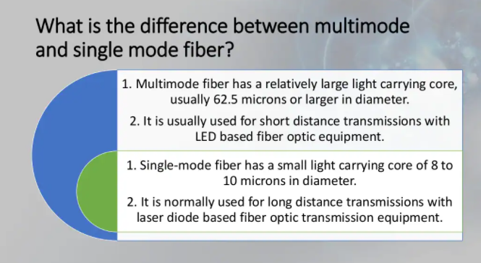

Slide 7
Based on Refractive Index

Slide 8
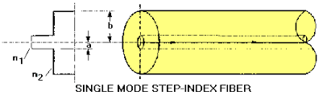
Single mode step index fiber
A single mode or monomode step index fiber allows the propagation of only one traverse electromagnetic mode and hence the core diameter must be of the order of 2 µm to 10µm. It has high information carrying capacity.

Slide 9
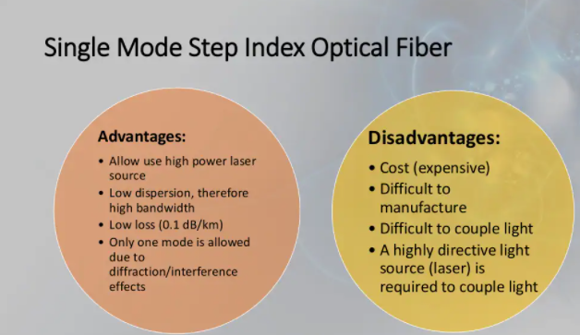

Slide 10
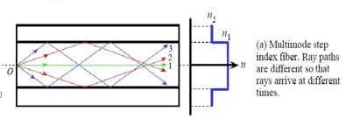
Multi mode Step Index fiber
The Refractive index for core and cladding are constant.
The light ray propagate through it in the form of meridional rays which cross the fiber axis during every reflection at the core cladding boundary.

Slide 11
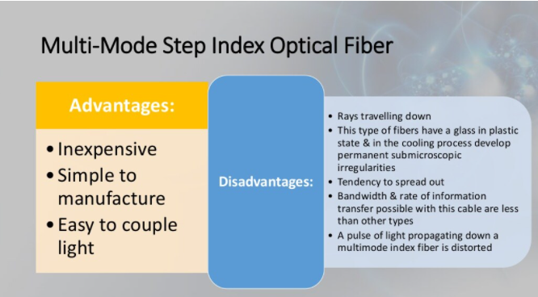

Slide 12
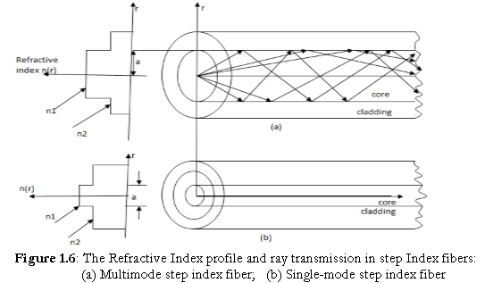
Single mode and multimode step index fiber

Slide 13
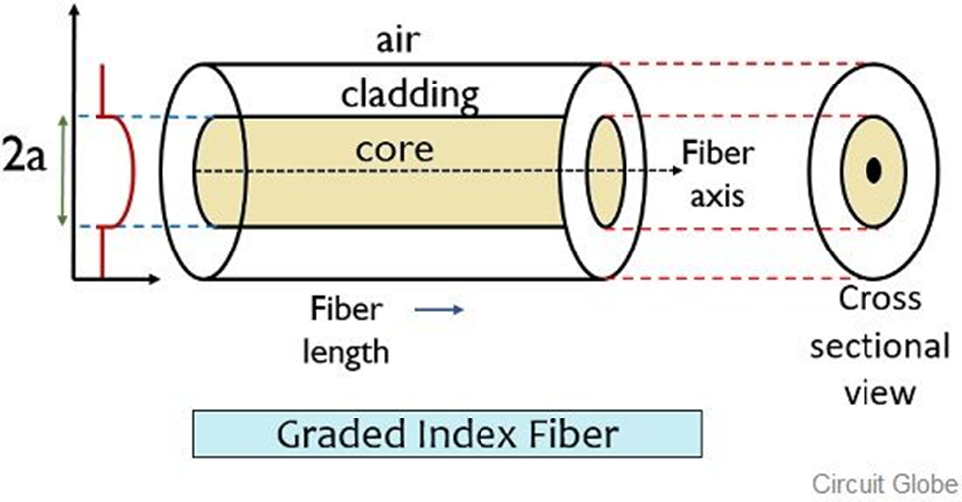
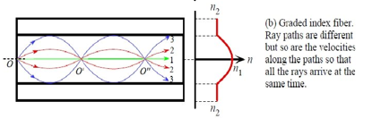
Multimode Graded Index fiber
Fiber core has a non-uniform refractive index that gradually decreases from the center towards the core cladding interface.
Cladding has uniform Refractive index,
Light rays propagate through it in the form of helical rays.

Slide 14
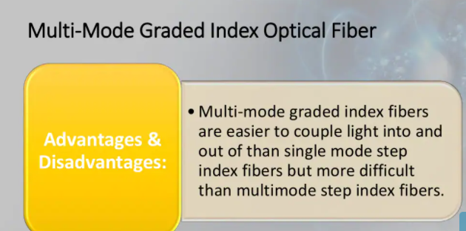

Slide 15
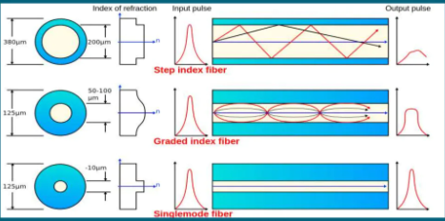
Based on the refractive Index

Slide 16
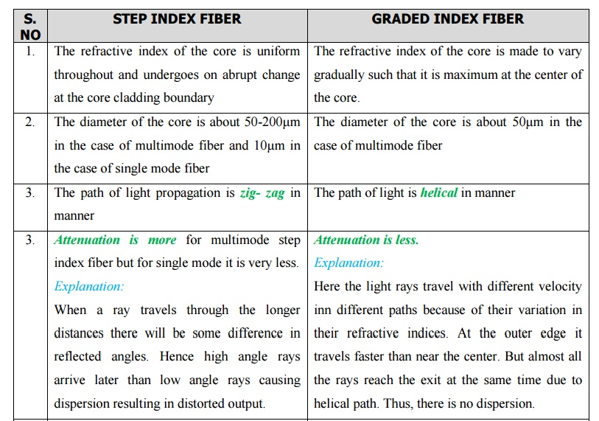

Slide 17
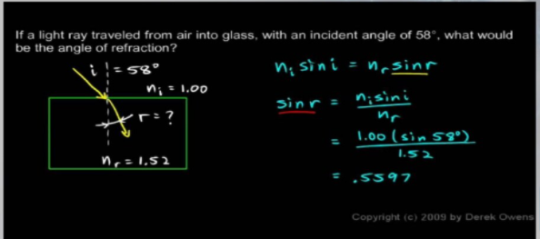
Problem

Slide 18
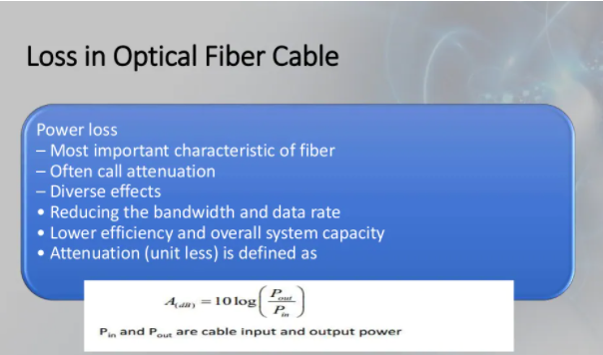

Slide 19
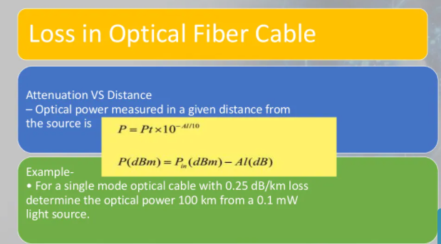

Slide 20
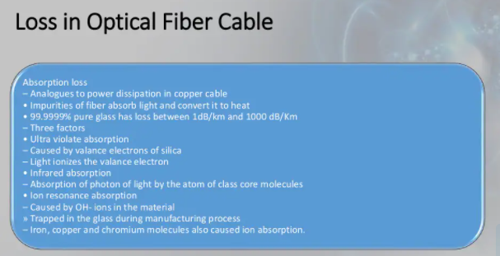

Slide 21
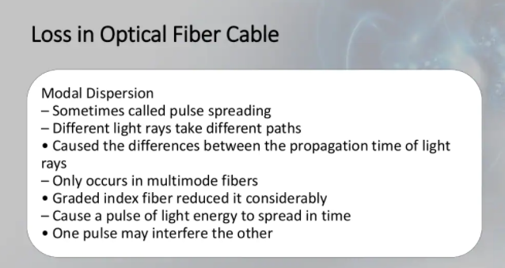

Slide 22
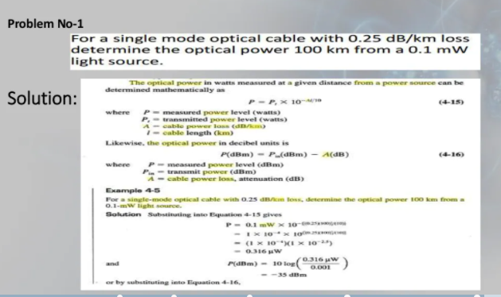

Slide 23
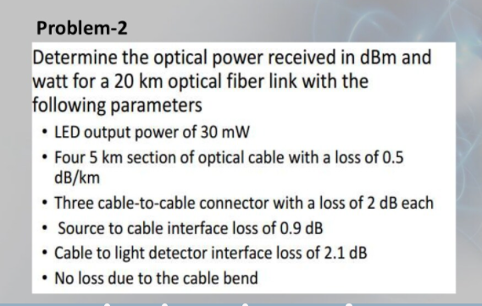

Slide 24
